Slide 1
Appendix 2- Chapter 28

Slide 2
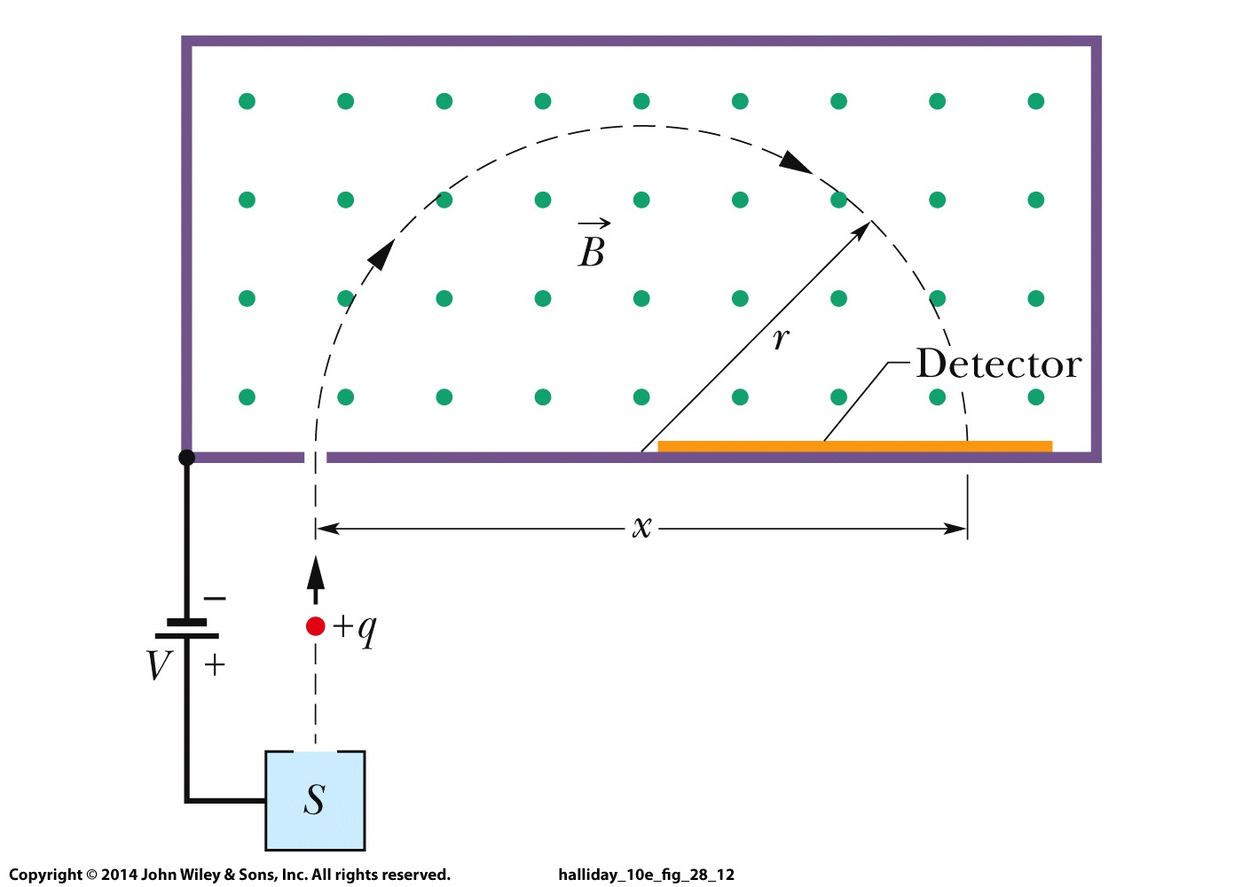
Application: Mass Spectrometer

Slide 3
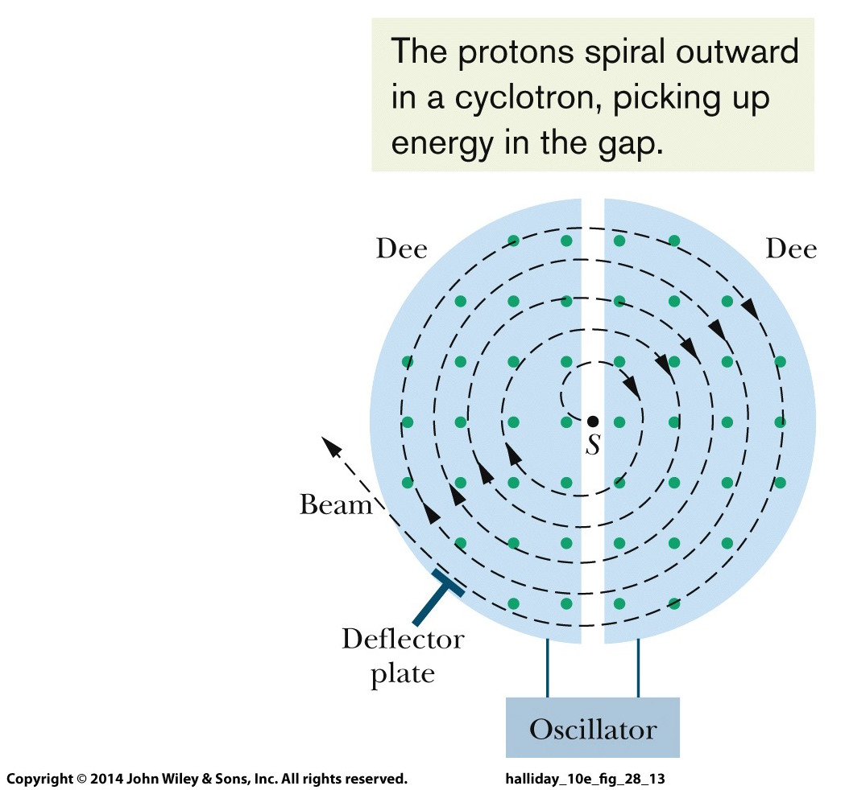
Application: Cyclotron
In the gap between the dees, charges are accelerated by E-field:
After N times through the gap:

Slide 4
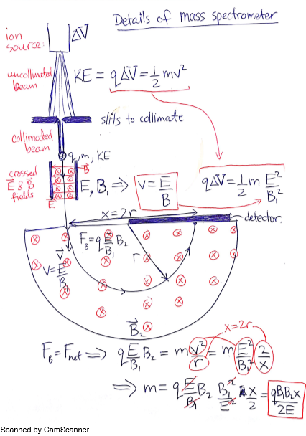

Slide 5
